Slide 1
Types of Data Analysis
Overview

Slide 2
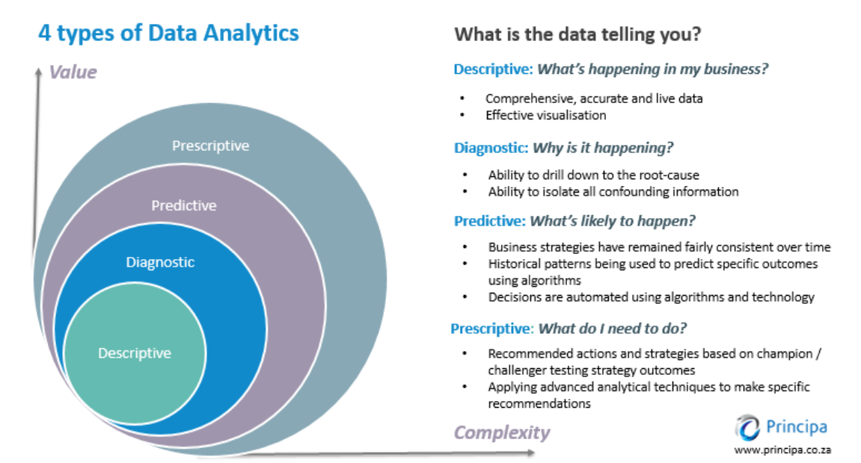
Types of Data Analysis
Descriptive analytics:
What happened?
Diagnostic analytics:
Why did it happen?
Predictive analytics:
What is likely to happen in the future?
Prescriptive analytics:
What’s the best course of action?
Note: Mainly these 4, there are few more like Inferential Analysis, Causal Analysis, Mechanistic Analysis, etc.
Image Source: principa.co.za

Slide 3
Descriptive Analysis
It's the analysis of data that helps describe, show or summarize data in a meaningful way such that, for example, patterns might emerge from the data. Descriptive statistics do not, however, allow us to make conclusions beyond the data we have analysed or reach conclusions regarding any hypotheses we might have made. They are simply a way to describe our data.
Mainly two general types of statistic that are used to describe data:
Measures of central tendency(Mean/Median/Mode)
Measures of spread(Variance/Standard deviation/ Range/Quartiles/Skewness/Kurtosis)

Slide 4
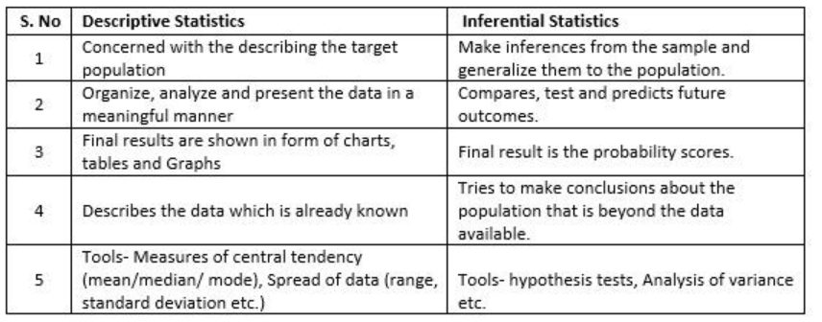
Inferential Analysis
Inferential statistics enables one to make descriptions of data and draw inferences and conclusions from the respective data.
Inferential statistics uses sample data because it is more cost-effective and less tedious than collecting data from an entire population.
It allows one to come to reasonable assumptions about the larger population based on a sample’s characteristics.
Uses: Population Parameters, Sample Statistics, Sampling Errors, Confidence Intervals, and Hypothesis Testing
Image Source: Google Images

Slide 5
Diagnostic Analysis
Diagnostic analytics seeks to look deeper in order to understand why something happened. The main purpose of diagnostic analytics is to identify and respond to anomalies within your data.
For example: If your descriptive analysis shows that there was a rise of 20% defects in the production for 2021 Q1, you’ll want to find out why. The next logical step is to perform a diagnostic analysis.
When running diagnostic analytics, there are a number of different techniques that you might employ, such as probability theory, regression analysis, filtering, and time-series analysis.

Slide 6
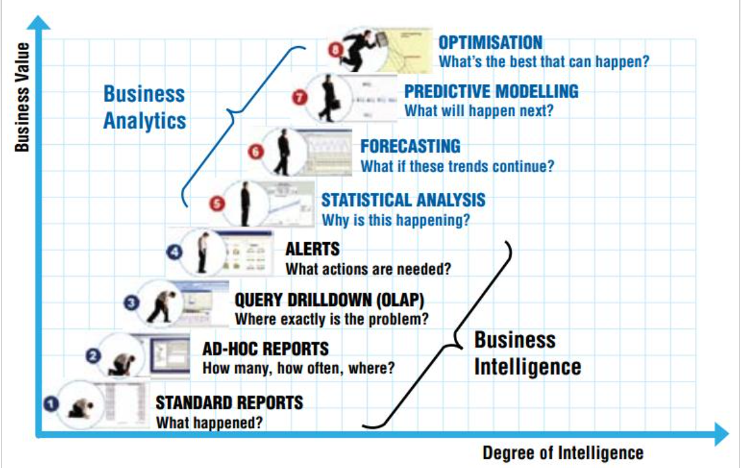
Predictive Analysis
Predictive analytics is all about forecasting. Whether it’s the likelihood of an event happening in future, forecasting a quantifiable amount or estimating a point in time at which something might happen – these are all done through predictive models.
Machine learning and Deep Learning are the branch of predictive analytics.
Predictive analytics builds on what happened in the past and why to predict what is likely to happen in the future.
Image Source: datasciencecentral.com

Slide 7
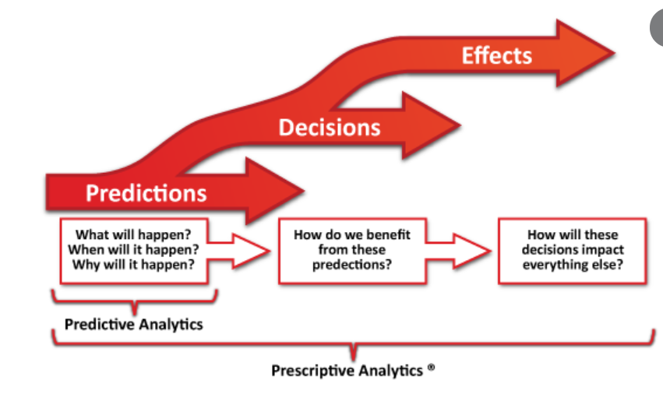
Prescriptive Analysis
Prescriptive analytics looks at what has happened, why it happened, and what might happen in order to determine the best course of action for the future.
Prescriptive analytics is the natural progression from descriptive and predictive analytics procedures. It goes a step further to remove the guesswork out of data analytics. It also saves data scientists and marketers time in trying to understand what their data means and what dots can be connected to deliver a highly personalized and propitious user experience to their audiences.
Prescriptive analytics is, without doubt, the most complex type of analysis, involving algorithms, machine learning, statistical methods, and computational modeling procedures
Image Source: Google Images

